Slide 1
Regular Expressions
DATA STRUCTURES Zeinab Ibrahim 202111149

Slide 2
Why use Regular expressions
Regular Expressions in C++ are an important part of programming which helps is finding a pattern that consists of a sequence of characters. It is also known as “ Regex “ and it is used to define a pattern that can be used in string searching algorithms.
Regular expressions are useful in search and replace operations. The typical use case is to look for a sub-string that matches a pattern and replace it with something else.

Slide 3
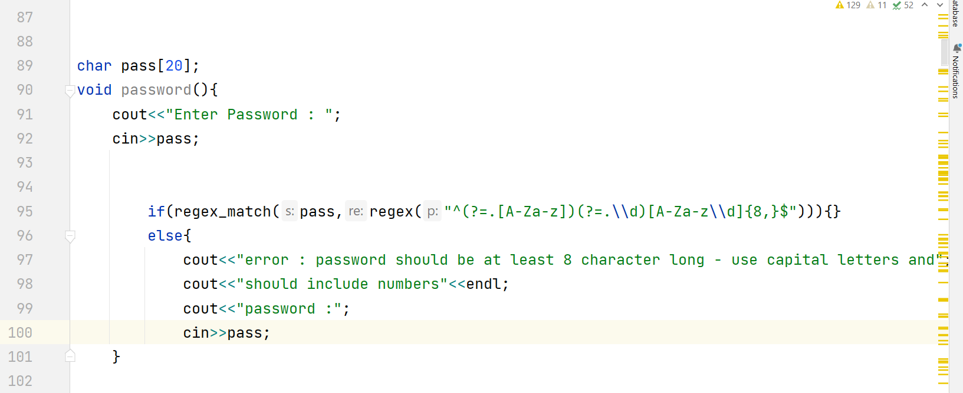
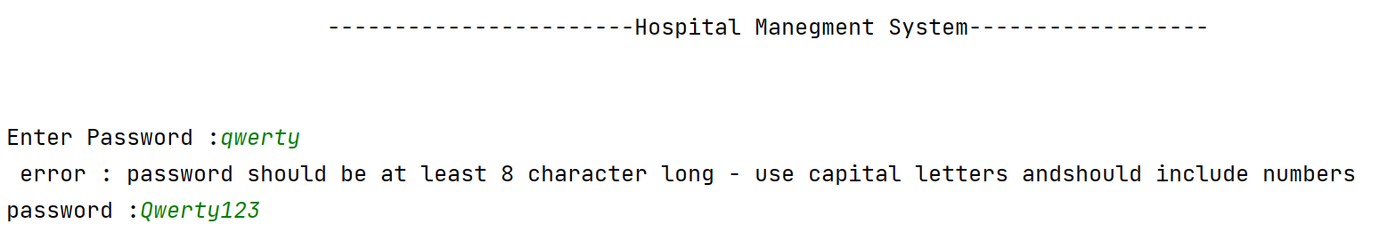
Password validation
Regex code

Slide 4
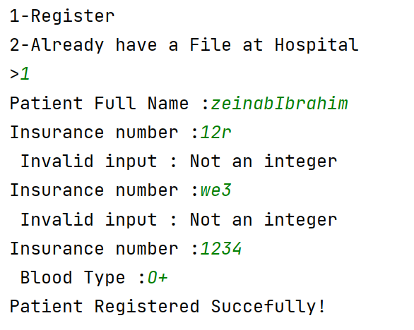
Validate Insurance number
As we know The Hospital Insurance number can never include letters .

Slide 5
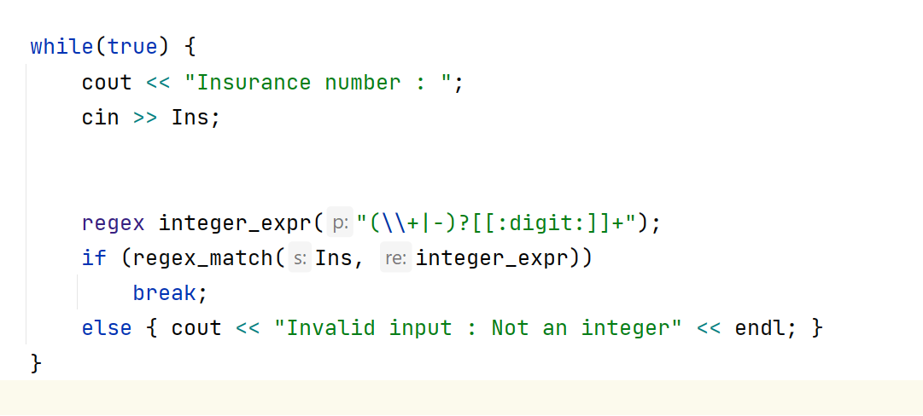
code

Slide 6
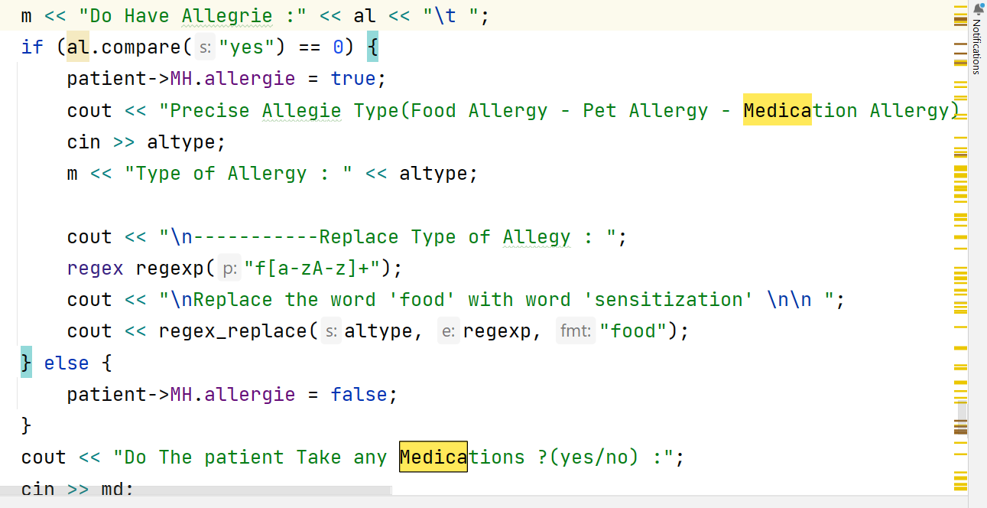
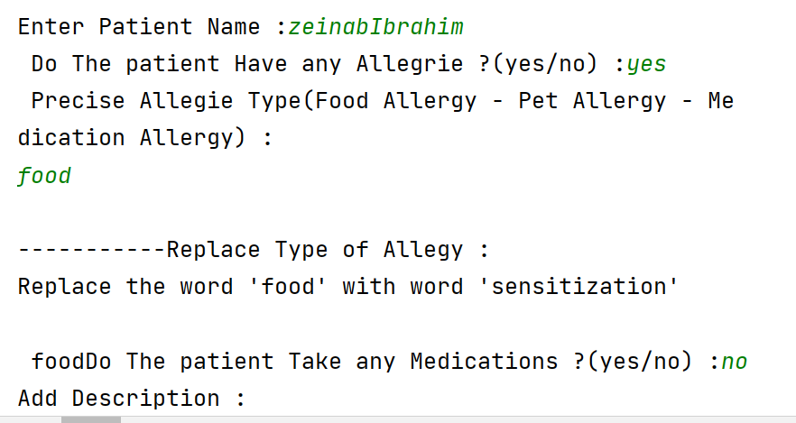
‘Replace’ using regular expression

